Slide 1
Asthma and COPD

Slide 2
Pathophysiology of Asthma
Characterized by immune response in bronchial airways, causing constriction and difficulty breathing
Often triggered as response to environmental stimuli

Slide 3
Inception during Childhood
Genetically-determined sensitization risk attributable to:
Delayed postnatal Th cell maturation
Developmental defects in Treg cells
Altered innate immune system

Slide 4
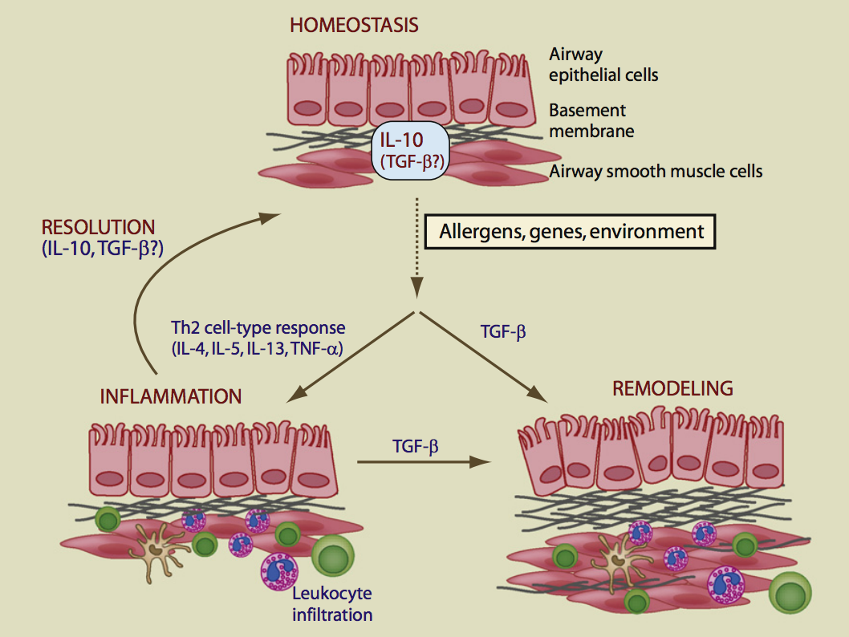
Typical Immune Homeostatis
Notes:
IL-10 plays a central role in this process, but the role of TGF-b is less clear
Exposure to allergens associated with Th2 cell type immune response characterized by IL-4, IL-5, IL-13, and TNF, which culminates in leukocyte infiltration of the lungs

Slide 5
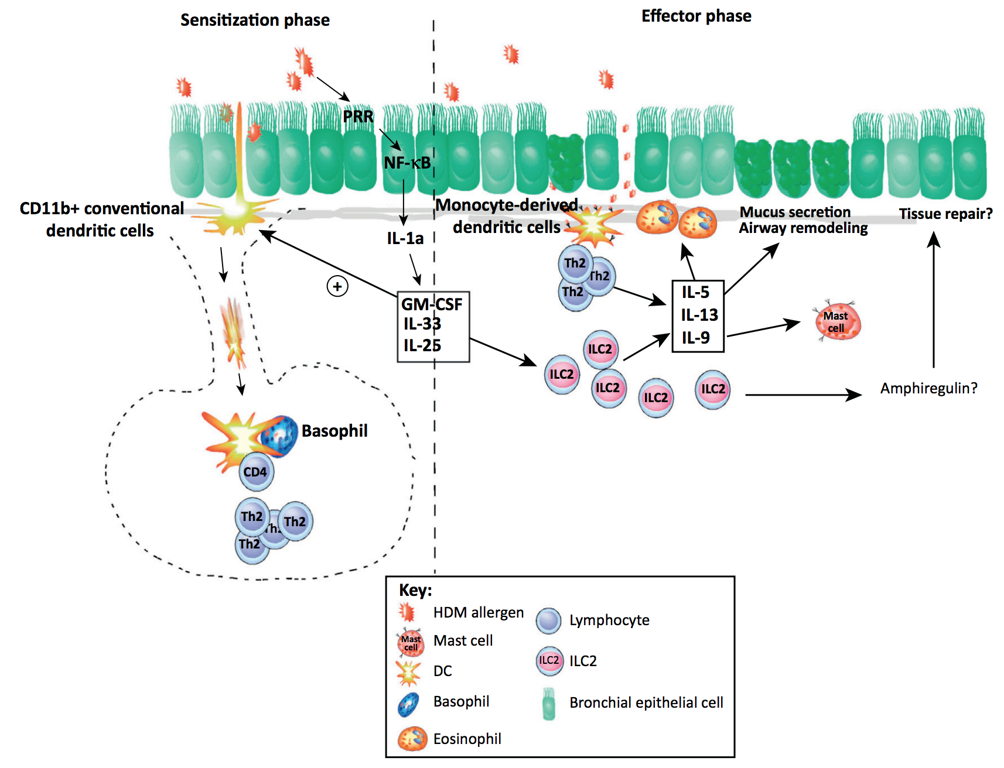
TH2 Sensitization to Allergens
Notes:
the incoming allergen will trigger pattern recognition receptors (PRRs) expressed by lung epithelial cells.
These cells release interleukin (IL)-1a
These induce the release of innate cytokines granulocyte–macrophage colony-stimulating factor (GM-CSF), IL-25, and IL-33.
These cytokines will:
(i) activate lung dendritic cells (DCs) to migrate to the draining lymph nodes and instruct them to induce Th2 cell differentiation
(ii) induce the expansion/activation of group 2 innate lymphoid cells (ILC2s), which produce Th2 cytokines.
Upon re-exposure to the allergen (effector phase; right), lung DCs reactivate Th2 cells locally to produce the Th2 cytokines IL-5, IL-9, and IL-13.
Epithelial cells triggered by the allergen produce IL-33 and IL25, which expand and activate ILC2s to produce the same cytokines as Th2 cells.
These cytokines induce eosinophilia, increase mast cell numbers in the lungs, and induce mucus production by epithelial cells and airway remodeling. Upon repeated exposure to allergens, ILC2s might also make amphiregulin and contribute to tissue repair. Abbreviation: NF-kB, nuclear factor-kB.

Slide 6
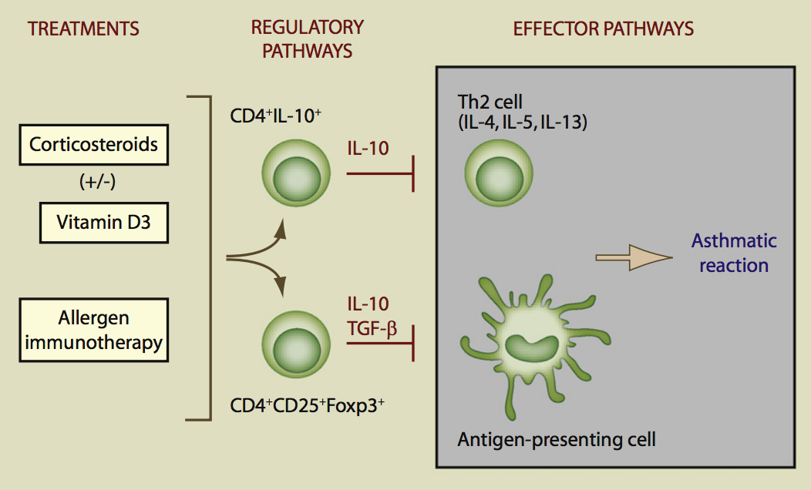
Therapies for Asthma

Slide 7
The Role for IL-10
Broad immunosuppressive and anti-inflammatory actions
Inhibitor of pro-inflammatory cytokine production; dampens T cell activation
Corticosteroid therapies associated with IL-10 production by CD4⁺ T cells

Slide 8
Novel Therapies for Asthma
100 mediators are involved in the asthmatic inflammatory process
Currently only use antileukotrienes (weakly effective)
Cytokines promising targets for novel therapies

Slide 9
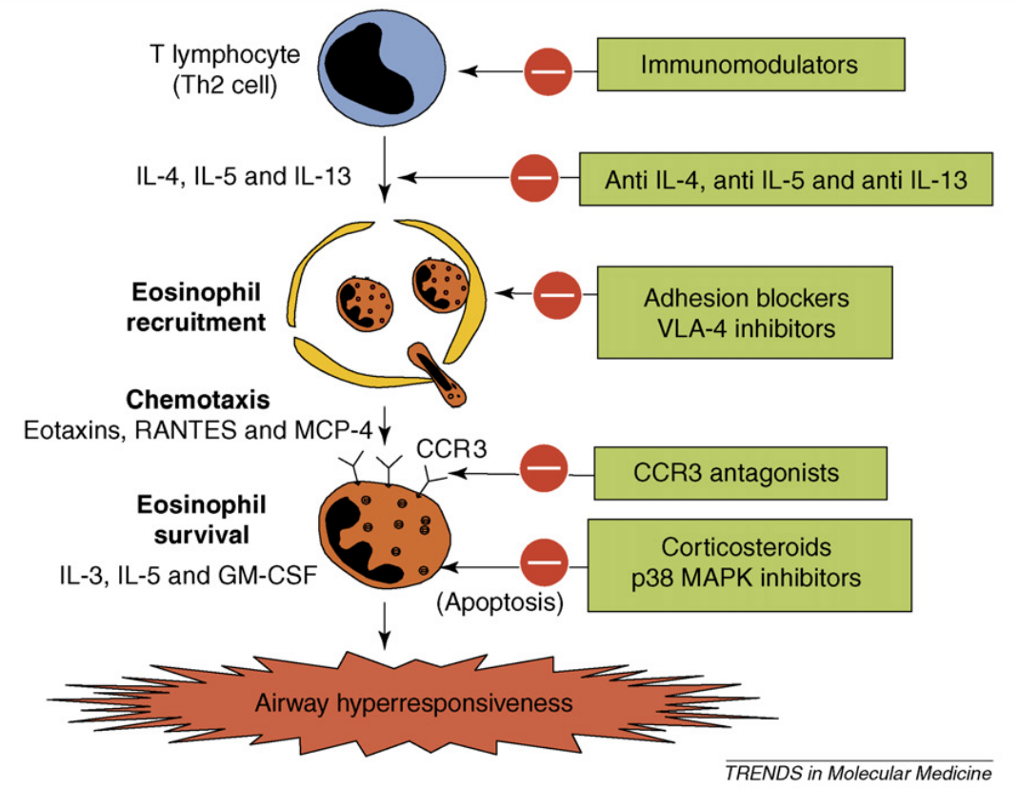
Novel Therapies for Asthma

Slide 10
COPD Pathophysiology
Obstructive lung disease characterized by chronically poor airflow
Symptoms include shortness of breath, cough, and sputum production
Tobacco smoking most common causal agent

Slide 11
Management of COPD
Inhaled bronchodilators among most common medications
Inhaled corticosteroids may be added if necessary
Treatments are only palliative; no cures exist

Slide 12
References
Anderson, G., & Cookson, W. (1999). Recent advances in the genetics of allergy and asthma. Molecular Medicine Today, 5, 264 – 273.
Barnes, P. (2006). New therapies for asthma. Trends in Molecular Medicine, 12, 515 – 520. doi: 10.1016/j.molmed.2006.09.006
Deckers, J., Madeira, F., & Hammad, H. (2013). Innate immune cells in asthma. Trends in Immunology, 34, 540 – 547. doi: 10.1016/j.it.2013.08.004
Lloyd, C., & Hawrylowicz, C. (2009). Regulatory T cells in asthma. Immunity, 31, 438 – 449. doi: 10.1016/j.immuni.2009.08.007
Maddox, L., & Schwartz, D. (2002). The pathophysiology of asthma. Annual Review of Medicine, 53, 477 – 498. doi: 10.1146/annurev.med.53.082901.103921
Strickland, D., & Holt, P. (2011). T regulatory cells in childhood asthma. Trends in Immunology, 32, 420 – 427. doi: 10.1016/j.it.2011.06.010 T

